Slide 1
The Exam Scheduling Problem
A schedule is a mapping from courses to rooms at times
soft constraints: the happiness of students and rooms on a schedule
Goal: solve exam scheduling problem using a genetic algorithm, random search, hillclimbing, and a variant of simulated annealing

Slide 2

Fitness function?

Slide 3
Genetic Algorithm
It maintains a population of schedules and constructs subsequent generations
To generate a new schedule: random, copying, mutation, crossover
Mutation/crossover: schedules are selected with a probability proportional to their fitness.
free parameters: size of the population, number of generations, proportions of copy, random, mutation, and crossover

Slide 4
other search algorithms.
Random Search: randomly generate some schedules, return the one with highest fitness.
mutate-search: Make 1% changes to the current best one and check the fitness. If the new one is better, replace the old one.
Hill Climbing: examines every schedule in the neighborhood of a given schedule, then continues from the best one, until it reaches the maximum number of evaluation allowed.

Slide 5
Testing data
 | Small | Medium | Large | Small w/ Correlations | Medium w/ Correlations | Large w/ Correlations
Days | 7 | 10 | 7 | 7 | 10 | 7
Time slots | 5 | 8 | 8 | 5 | 8 | 8
Courses | 20 | 200 | 603 | 20 | 200 | 600
Rooms | 4 | 10 | 43 | 4 | 10 | 43
Students | 50 | 300 | 21945 | 50 | 300 | 21945
Courses taking | 1-5 | 1-6 | 1-5 | 2-6 | 2-6 | 2-6
Number of Majors | N/A | N/A | N/A | 4 | 10 | 20
Search space size | 10¹⁸² | 10¹⁸⁴⁰ | 10⁶⁶⁹⁵ | 10¹⁸² | 10¹⁸⁴⁰ | 10⁶⁶⁸⁹

Slide 6
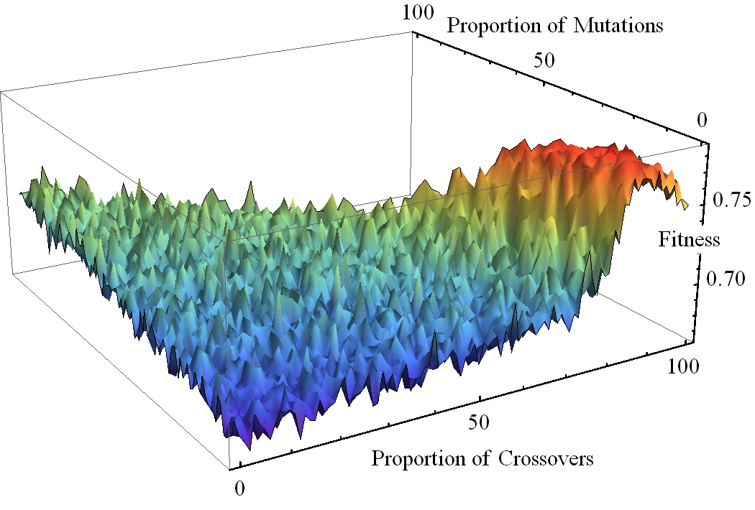
Crossover is outperforming

Slide 7
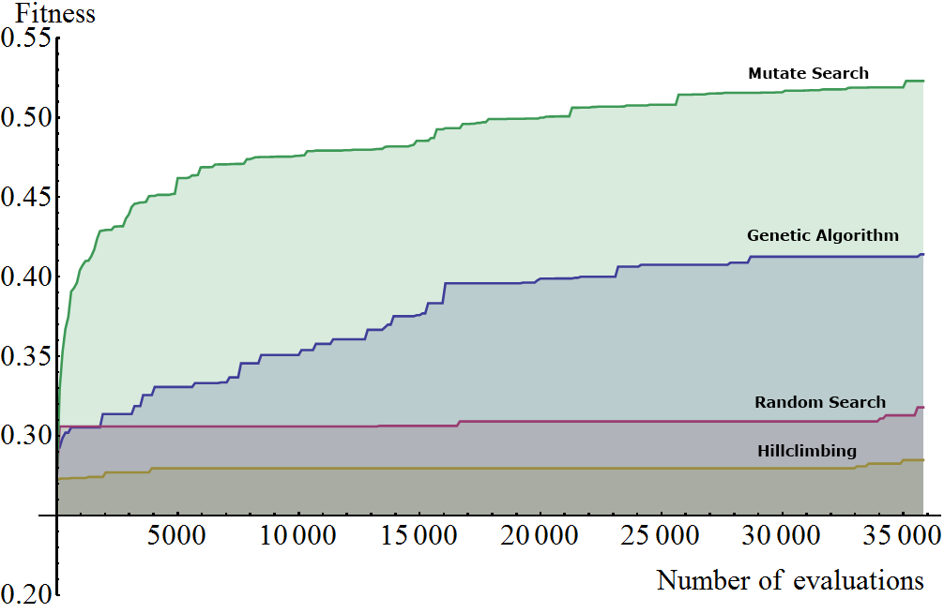
Algorithm Comparison

Slide 8
Other notes
Development tools: java and mathematica

Slide 9
Conclusions

